Slide 3
Sudha Moorthy was born on 19 August 1950.
She is a social worker and writer in kannada and English language.
Her works mainly focus on the sectors of health care , education , etc..
The book “ How I taught My Grandmother To Read “ has been translated in 15 languages.

Slide 8
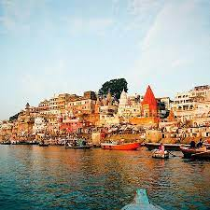
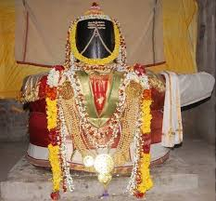
1

